Slide 1
Machine Learning
Lecture 1
By
Venkatesh.B IH201685013
Vikas.R IH201685100
Venkatesh.S IH201685090

Slide 2
Generalizing from examples
ML model's ability to perform well on new unseen data rather than just the data that it was trained on.
It is related to the concept of overfitting. If the model is overfitted then it will not generalize well.

Slide 3
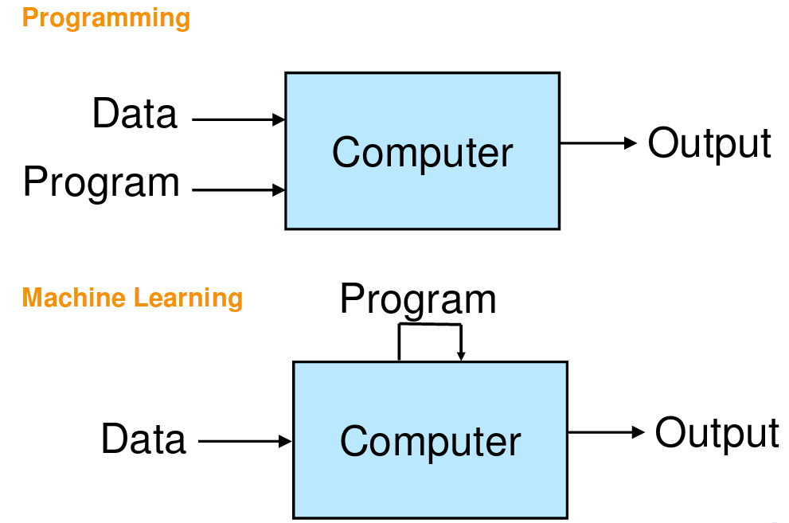
Automatically learn programs from data
Algorithms that can improve performance using training data.
Typically, a large number of parameter values learned from data.
Applicable to situations where challenging to define rules manually.

Slide 4
Applications
Web Search
Spam filters
Recommender Systems
Ad Placement
Credit Scoring
Fraud Detection
Stock Trading
Drug Design

Slide 5
Classification
Identifying to which of a set of categories a new observation belongs, on the basis of a training set of data containing observations whose category membership is known.
Consider a senario where an IIM aspirant wants to join IIM Ahmadhabad, lets see whether the person gets selected or not.
The deciding factors are CAT Score, Interview Score, Work Experience.

Slide 6
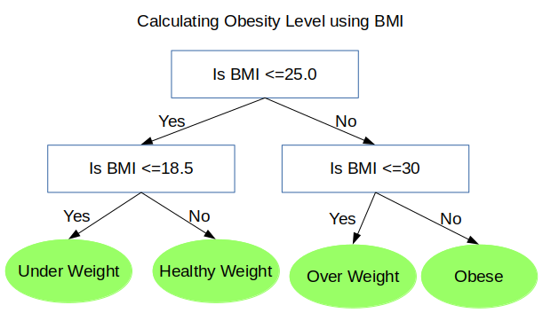
Decision Trees
A decision tree is a decision support tool that uses a tree-like graph or model of decisions and their possible consequences, including chance event outcomes, resource costs, and utility.

Slide 7
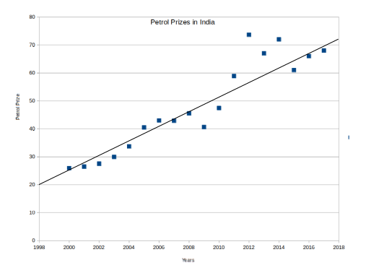
Linear Regression
Linear approach for modeling the relationship between a scalar dependent variable y and one or more explanatory variables denoted X.
Consider the petrol prizes(x-axis) corresponding to each year (y-axis) in India.

Slide 8
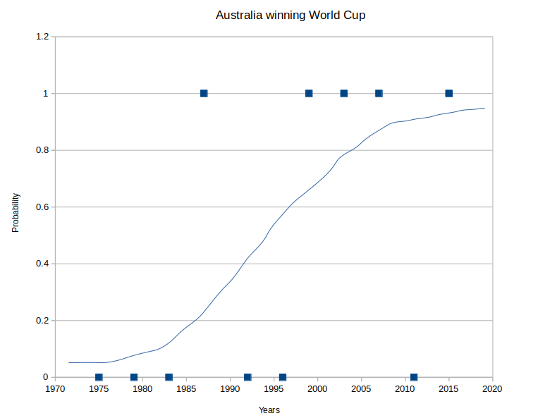
Logistic Regression
It is a regression model where the dependent variable is categorical.
Probabilty of Australia winning world Cup.
The deciding factors are Favouring Pitches, Earlier track record- Wins,loses,Years, Players Performance.
Ref:https://en.wikipedia.org/wiki/Cricket_World_Cup

Slide 9
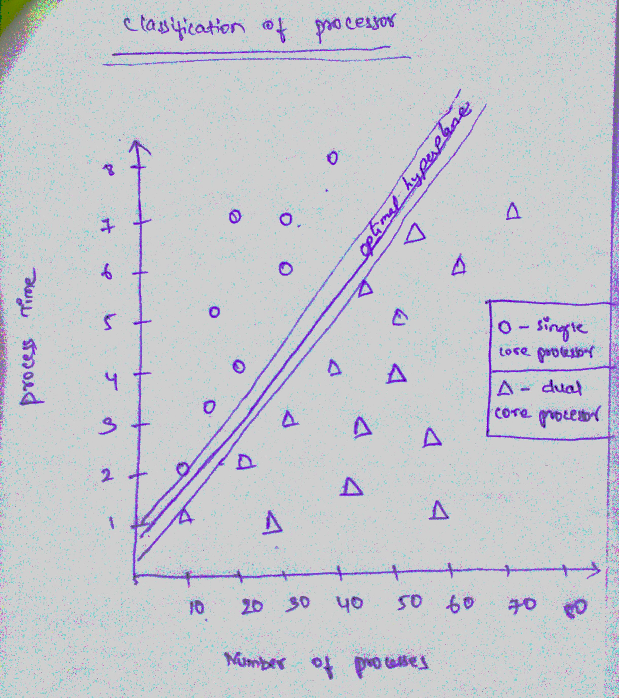
Support Vector Machine
A discriminative classifier formally defined by a separating hyperplane. Given labeled training data the algorithm outputs an optimal hyperplane which categorizes new examples.
Consider example of processes and its process times which classifies the core of processor.

Slide 10
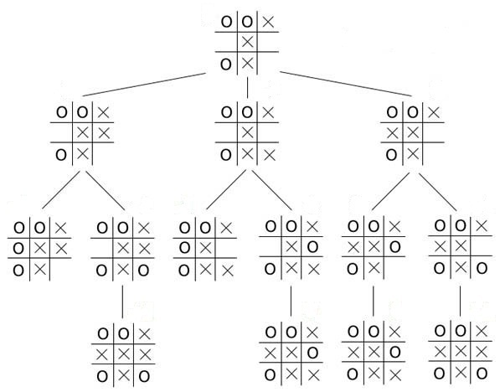
Neural Network
A computing system made up of a number of interconnected processing elements, which process information by their dynamic state response to external inputs.
Consider the example of Tic Tac Toe at a state in a game and its possible outcomes.

Slide 11
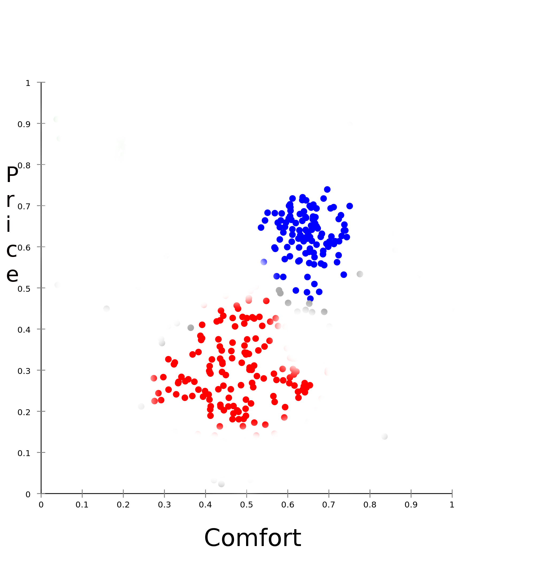
Clustering
Task of grouping a set of objects in such a way that objects in the same group are more similar to each other than to those in other groups.
Consider an example of identifying Car types depending on the factors comfort(in scale 0 to 1 on x axis) and Price(in millions on y axis).

Slide 12

K-Means
Starts with k initial clusters as specified. At each iteration, the records are assigned to the cluster with the closest centroid, or center.
Consider the above stated example of identifing Car types.

Slide 13
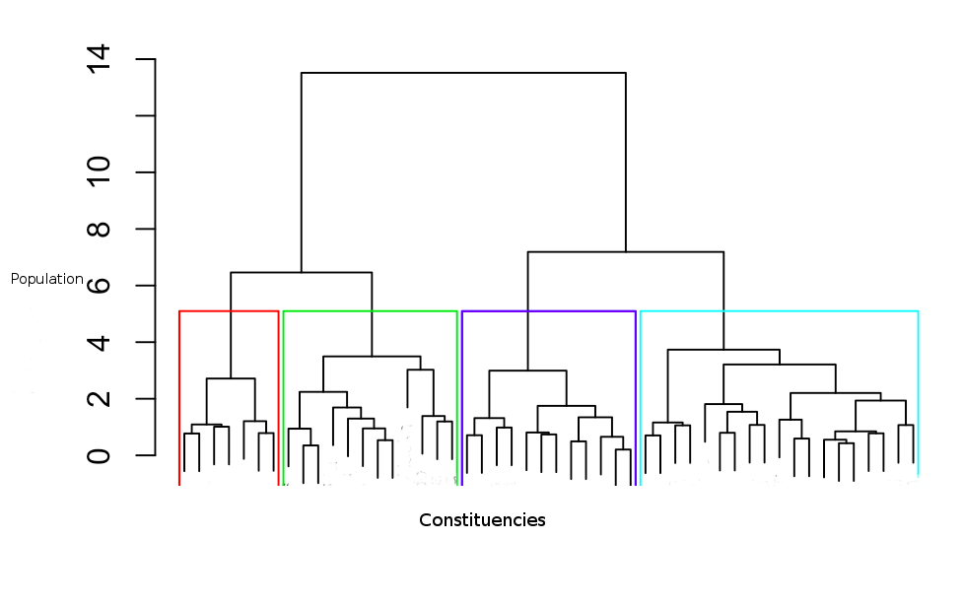
Hierarchical Clustering
It is a cluster analysis which seeks to build a hierarchy of clusters.
Cosider the example of Calculating population at each level by means of Election constituencies (x axis) and their respective Population(in hundred millions on y axis) of India.

